Slide 1
Crime in Chicago
By: Matt Macrides

Slide 2
Introduction
Chicago is the third largest city in the US by population (2020)
Publicized crime, particularly glorified in rap songs
Not all crime is created equal
Chicago is one of the most dangerous cities, yet the crime is centered in specific neighborhoods
The murder rate is 4 times above the national average
We wanted to look into this topic to see what types of crime is most prevalent, what districts are most effective, and if there are any explanatory variables associated with crime counts
Notes:
The 200 Largest Cities in the United States by Population 2022 (worldpopulationreview.com)

Slide 3



Data Sources
Looked at crimes rates in Chicago - Kaggle
Compared it with unemployment rates in Chicago - FRED Economic Data
Contrasted that data with the poverty stats of Chicago - WelfareInfo
Looked at Chicago police district data - Chicago Police
From 2012-2016

Slide 4

Users of the Database
President Barack Obama and First Lady Michelle Obama with Mayor Lori Lightfoot
Politicians / decision makers in the Chicago area
Residents and prospective movers
Former residents / donors looking to better the community
Notes:
Obamas back on the South Side for Presidential Center event | CNN Politics
Michelle Obama former resident of Chicago, her and Barack donated $2 million to Chicago funding for summer jobs back in 2017

Slide 5
Information Package
Information Subject: Crime in Chicago
Dimensions
District | Date | Domestic | Primary Type | Location Description | Case Number | Block | Arrest
District No. | Year | Domestic | Primary Type | Location Description | Case Number | Block | Arrest
District | Month
Facts: Unemployment rate, poverty rate, crime count per district, crime count per month, crime count per primary type, arrest % per primary type, arrest % per district
Categories
Notes:
District - Indicates the police district where the incident occurred.
Date when the incident occurred. this is sometimes a best estimate.
Domestic - Indicates whether the incident was domestic-related as defined by the Illinois Domestic Violence Act.
Primary Type - The primary description of the crime type
Location Description - description of the location where the incident occured
Case Number - The Chicago Police Department RD Number (Records Division Number), which is unique to the incident.
Block - The partially redacted address where the incident occurred, placing it on the same block as the actual address.
Arrest - Indicates whether an arrest was made.

Slide 6





Data Warehouse Tool Workflow
Notes:
Once we gathered the four separate source files, we began the ETL process in Python and Excel to 1) merge all data sources together and 2) convert our datasets into star schema. We used Python for about 85% of the process and Excel when programming was more difficult. Our finished program gave us the export files that we put into Dbeaver to show the Star Schema. Afterwards, we began visualizations in Tableau with that same data.

Slide 7
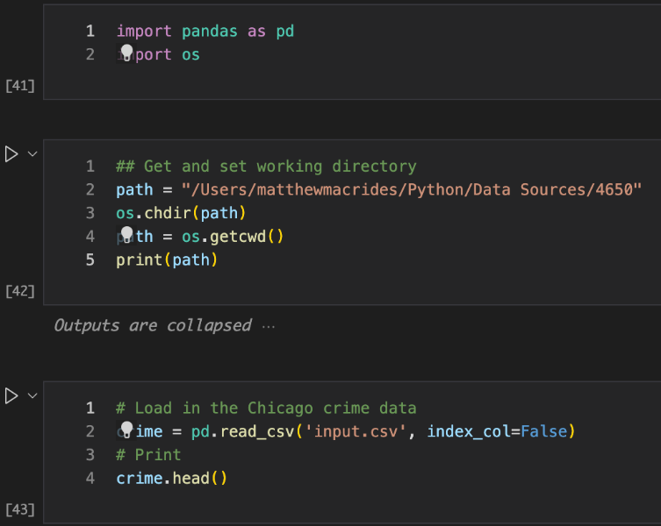
Our ETL Process
Load appropriate packages
Assign working directory to the file path that has our source files
Create ‘crime’ variable that holds the main/largest source file data
Notes:
Now, I want to walk you through our ETL process. Instead of going line by line in the Python program, I think it would be more beneficial to summarize each segment of code. So first, we loaded in the appropriate packages, Pandas and Os, which gave us the ability to call specific functions. Then we assigned the working directory of the program to the file path that also has three our source files. Our Kaggle source file is significantly larger than the other two so I started with that by creating a variable named ‘Crime’ that holds all the data from that source file.

Slide 8
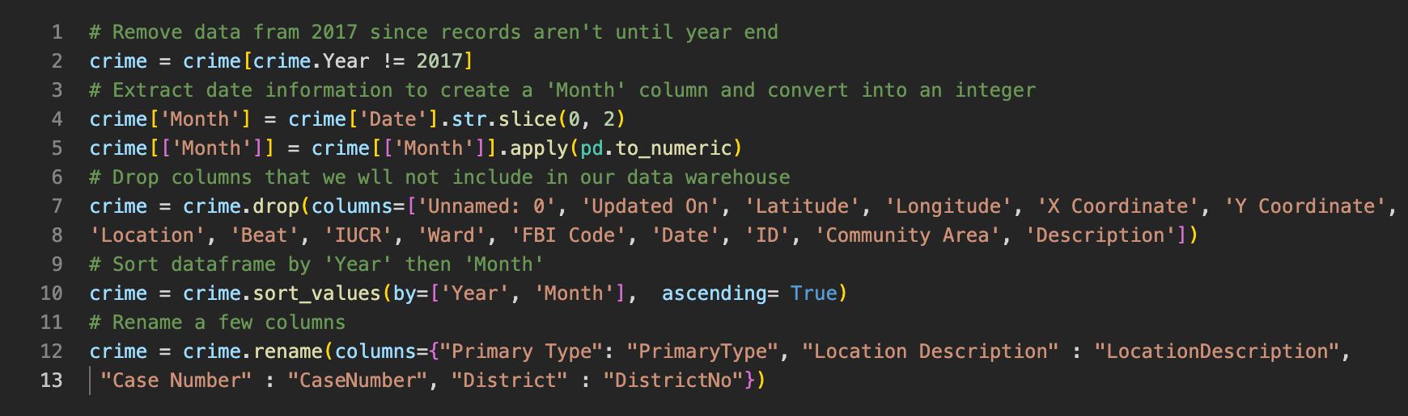
Our ETL Process
Modify the crime dataset
Remove unwanted data columns, create a month column from ‘Date’, sort dataframe, and rename some data columns
Notes:
Now we want to modify the Crime dataset (aka the kaggle dataset). So we removed several columns that we weren’t going to use, created a month column that was parsed out from the Date column, sorted the dataframe, and renamed some columns.

Slide 9
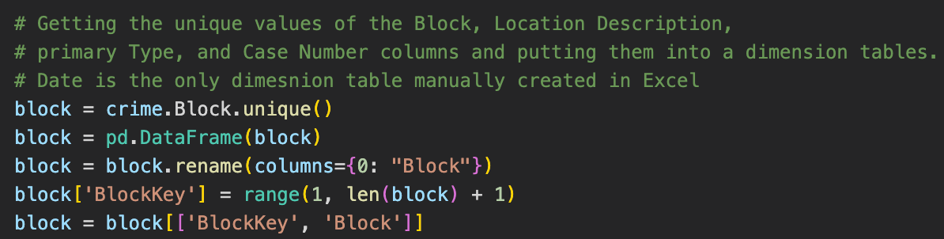
Our ETL Process
Creating Dimension Tables
Create a dataset with all the unique values of ‘Block’ from Crime dataset, create a unique primary key column within ‘Block’, rename columns and sort columns appropriately
We continue to do this for Location Description, Primary Type, and Case Number
Notes:
Now it’s time to start building the dimension tables. So, for example, Block was a column in the crime dataset that we wanted to make into its own dimension table. We found all the unique values for Block and created a dimension table with those values. Then we creates a unique primary key column within the block dimension table, renamed the columns and sorted the columns appropriately. We continued to do this for location description, primary type, and case number.

Slide 10
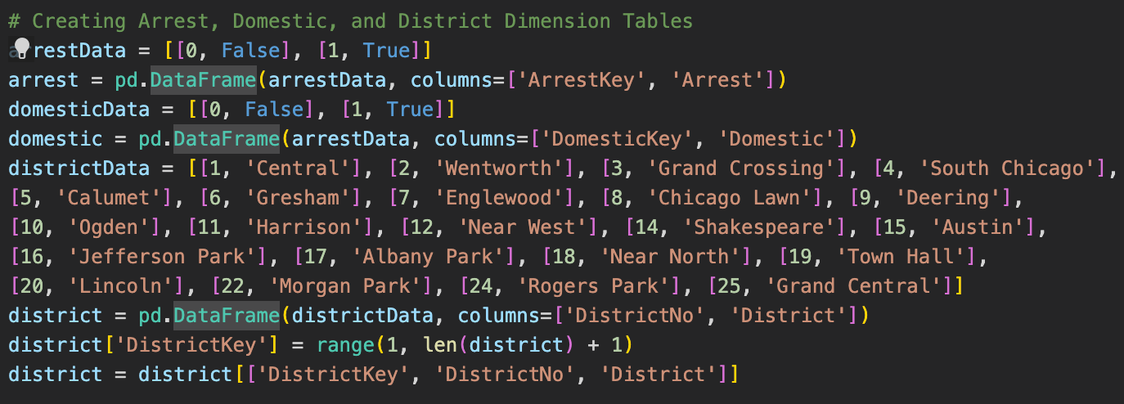
Our ETL Process
Manually ‘hard-coded’ Arrest, Domestic, and District dimension tables into Python
Notes:
For the arrest, domestic, and district dimension tables, we manually ‘hard-coded’ them into Python.

Slide 11
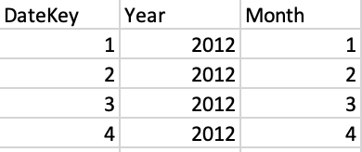
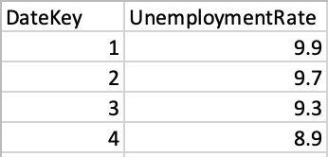
Our ETL Process
Date Dimension Table
Unemployment Rate Source Data
Manually created Date dimension table in Excel
Manually matched up unemployment rate and poverty rate data with the Date Key so we could join them in Python
Notes:
The last dimension table we want to make is Date. So we manually created this table in Excel on the Left. However, we also decided it was a good idea to match up the unemployment rate data source and poverty rate data source with the data key in Excel as well. This makes it significantly easier to join these data sources together in Python.

Slide 12
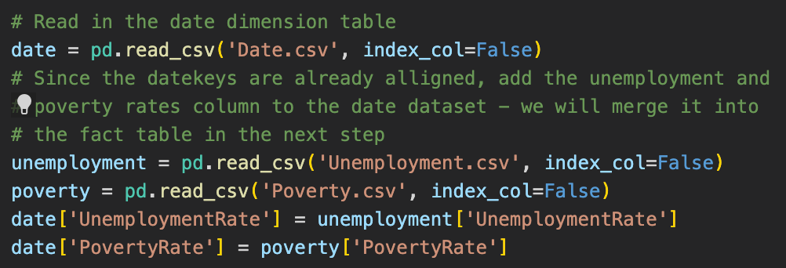
Our ETL Process
Read in the date dimension table, unemployment rate and poverty rate files
Append poverty rate and unemployment rate data onto date dimension table
Notes:
So, now that we created the Date dimension table in Excel, we read it into Python as well as the unemployment and poverty rate excel files. Then we append the poverty rate and unemployment rate data onto the date dimension table.

Slide 13
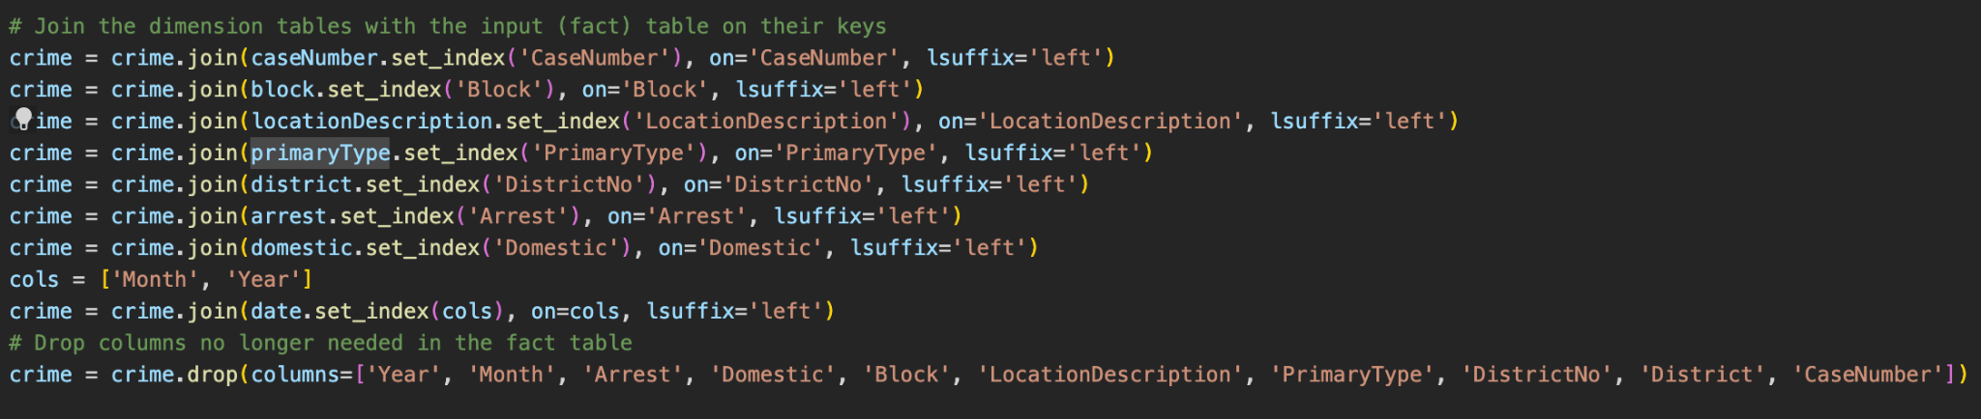
Our ETL Process
Join all the dimension tables on the fact(‘Crime’) table by their respective primary keys
Drop the value-containing columns from the fact table now that it has the dimension table keys
Notes:
We are almost done with the ETL process. Now we will join the dimension tables onto the Crime table by their respective primary keys and drop the value-containing columns from the crime table now that it has the primary keys. Our crime dataset is now starting to look like a fact table.

Slide 14
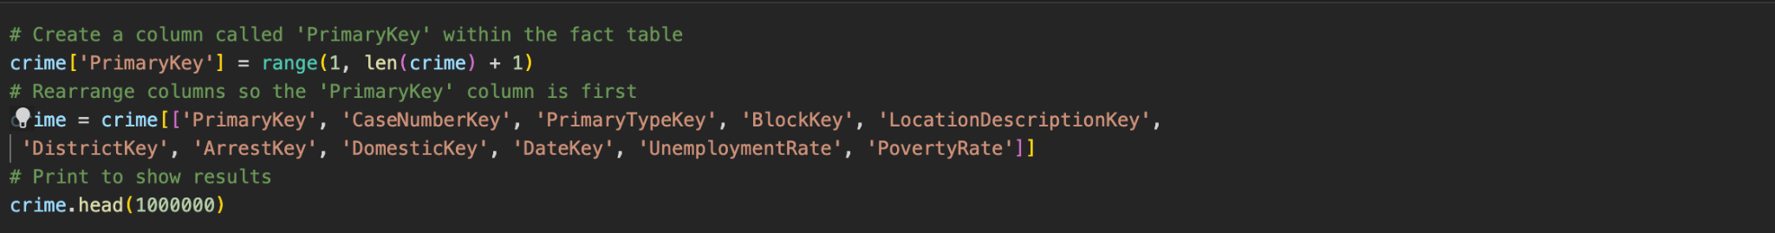
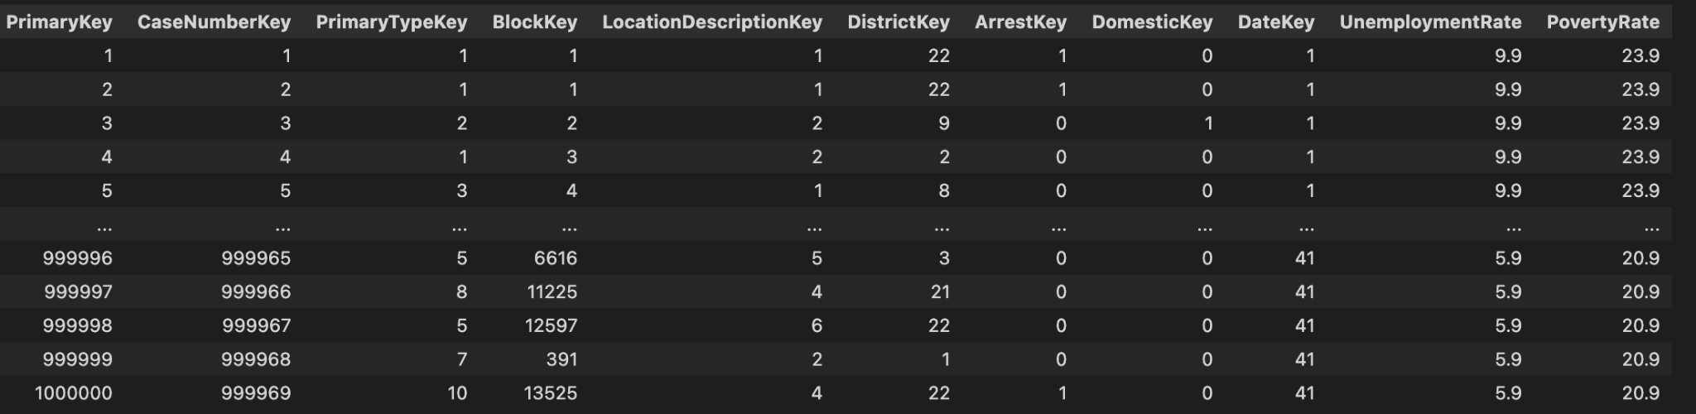
Our ETL Process
Create a unique primary key in the fact table, rearrange the columns, and print
Our final steps will be to generate CSV files so we can import the data onto Dbeaver and Tableau
Notes:
Lastly, we created a unique primary key in the crime dataset (fact table), rearranged the columns, and printed to the console which is what the bottom picture displays. Our final steps are to generate CSV files so we can import the data into Dbeaver and Tableau.

Slide 15
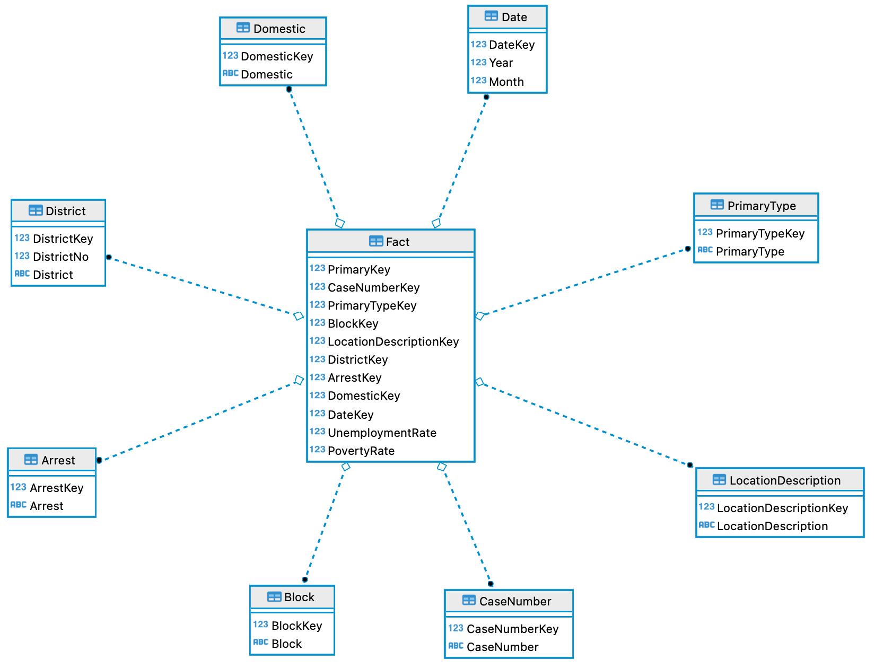
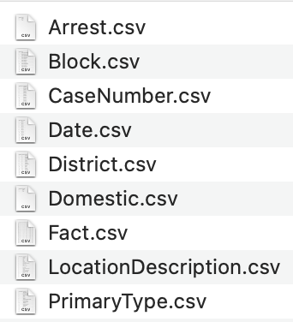
Database Contents and Schema
Notes:
Our ETL process generated 9 CSV files which is shown on the right. Each file represented one of our dimension/fact tables in our star schema. On the left is what our star schema looks like in Dbeaver.

Slide 16

Next Steps/More Time:
Try to find monthly poverty data to improve the regression analysis
Explore more potential explanatory variables
Compare Chicago crime data across decades or generations
Notes:
If we had more time it would be beneficial to find monthly poverty data to improve the regression analysis. Also it wouldn’t be a bad idea to explore more potential explanatory variables. One benefit of creating the ETL program in Python is that it would not be too hard to add more source files. Lastly, Kaggle had more data from previous years and comparing crime data across decades or generations could be insightful.

